Slide 1



Library management system
Name : adarsh VERMA
COURSE: HDFC API DEVELOPER (B1)
TRAINER: JAVEEd sir

Slide 2
Index
Introduction
Tools & Technology used
UML Diagrams
Requirements
Demonstration
Conclusion

Slide 3
Introduction
This project focuses on Simple and Small Library Management System Application
This software solution is designed to simplify the library management process, reduce administrative overhead, and improve the overall user experience.
In this presentation, we will discuss the functional and non-functional requirements of the application to give you a better understanding of its capabilities.

Slide 4
Tools & Technology used
Java programming language
Jpa spring boot
MySql Database
Swagger
Junit testing

Slide 5
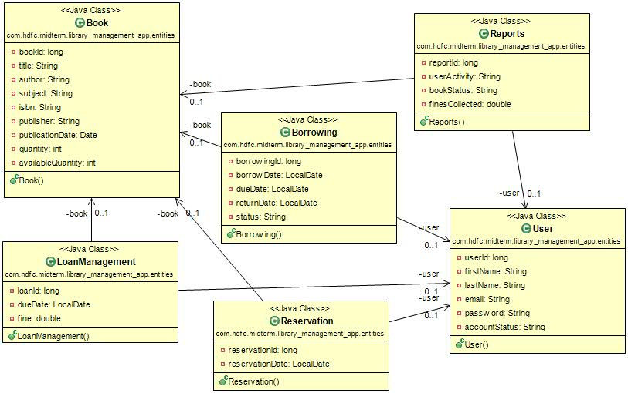
Ulm diagrams(class)

Slide 6
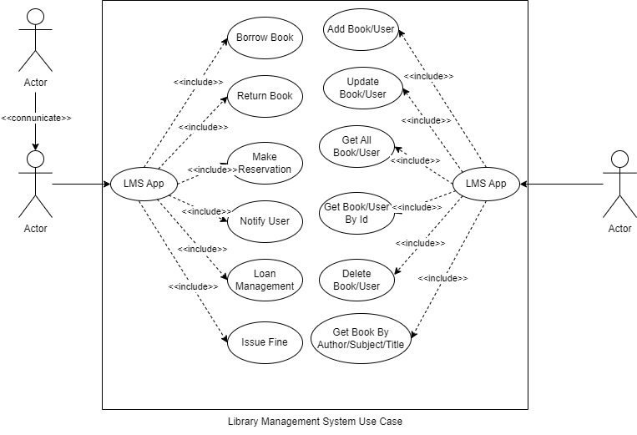
Ulm diagrams(use case)

Slide 7
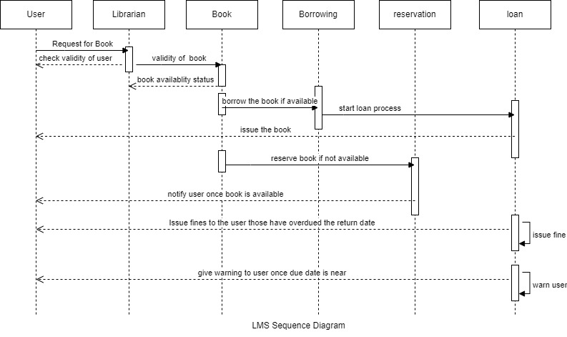
Ulm diagrams(sequence)

Slide 8
Functional requirements
1. User Management: The system should allow the librarian to manage user accounts, including registration, updating user information, and deleting user accounts.
2. Book Management: The system should allow the librarian to manage books, including adding new books, updating book information, and deleting books from the library.
3. Book Search: The system should allow users to search for books by title, author, or subject.
4. Book Borrowing: The system should allow users to borrow books from the library, subject to the availability of books.
5. Book Return: The system should allow users to return books to the library and update the book status as available.
6. Book Reservation: The system should allow users to reserve books that are currently checked out by other users.
7. Book Loan Management: The system should allow the librarian to manage book loans, including tracking book due dates, sending reminders to users, and issuing fines for overdue books.
8. Reports: The system should generate reports on the status of books, user activity, and fines collected.

Slide 9
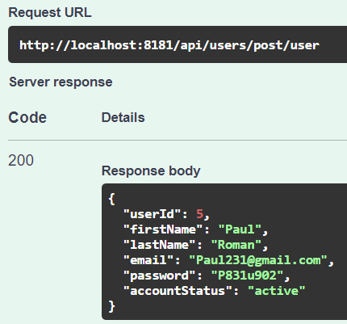
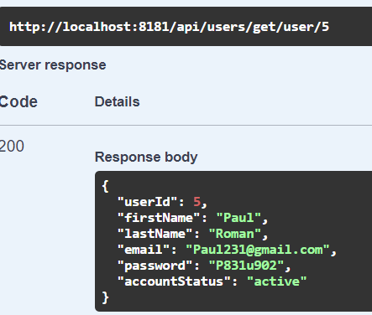
demonstration
User Management: The system should allow the librarian to manage user accounts,including registration, updating user information, and deleting user accounts.

Slide 10
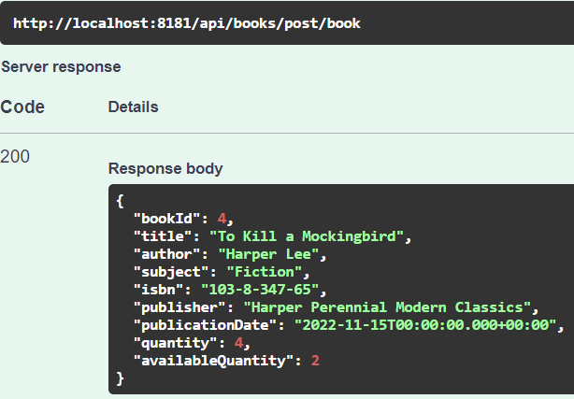
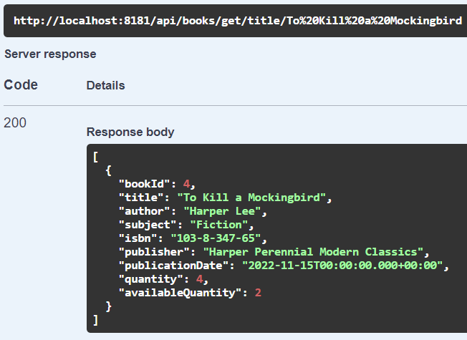
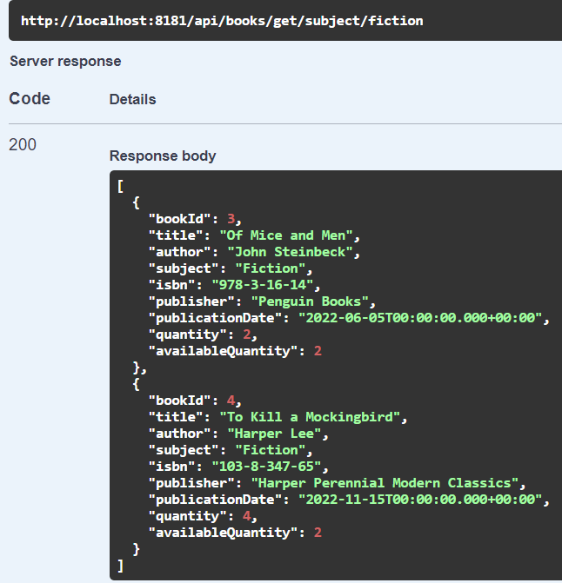
Demonstration
Book Management: The system should allow the librarian to manage books, including adding new books, updating book information, and deleting books from the library.
Book Search: The system should allow users to search for books by title, author, or subject.

Slide 11
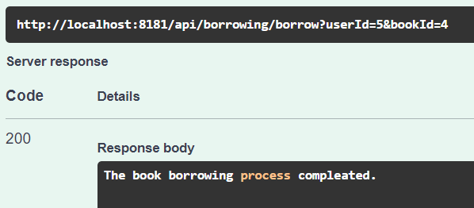
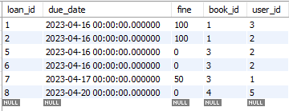
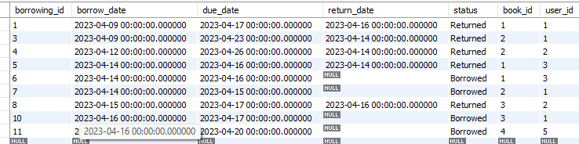
Demonstration
Book Borrowing: The system should allow users to borrow books from the library, subject to the availability of books.

Slide 12
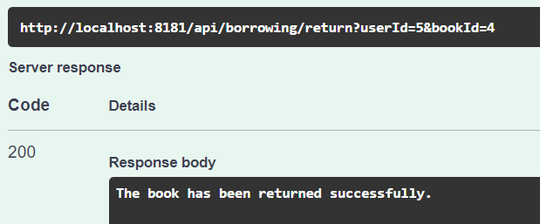
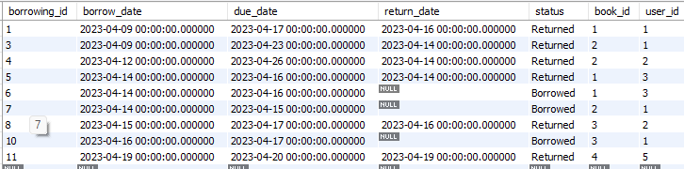
Demonstration
Book Return: The system should allow users to return books to the library and update the book status as available.

Slide 13
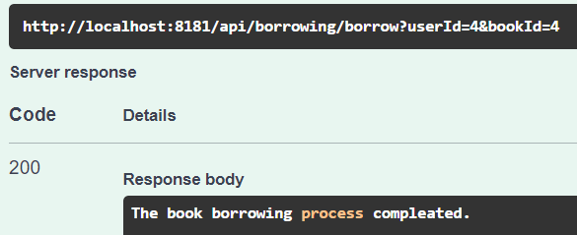
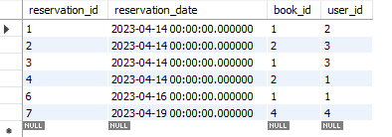
Demonstration
Book Reservation: The system should allow users to reserve books that are currently checked out by other users.

Slide 14
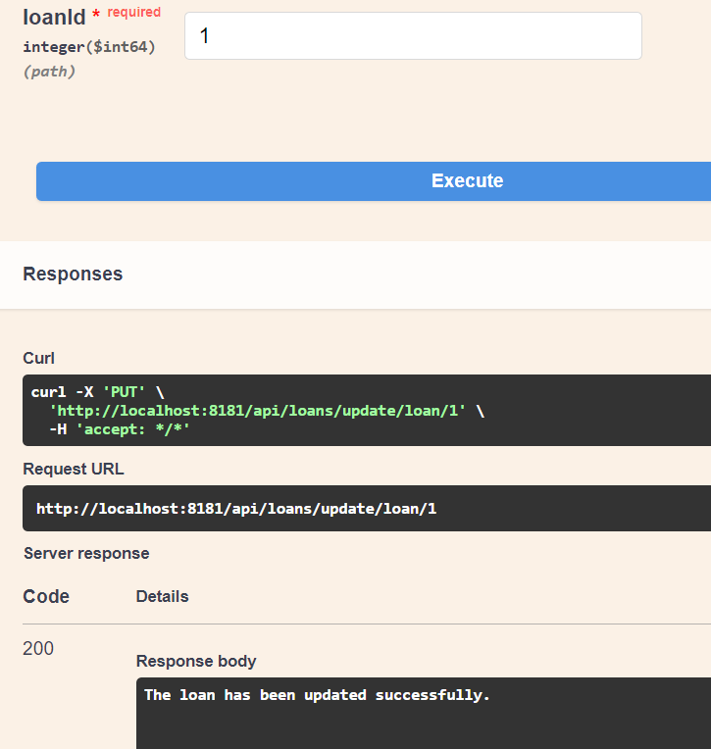
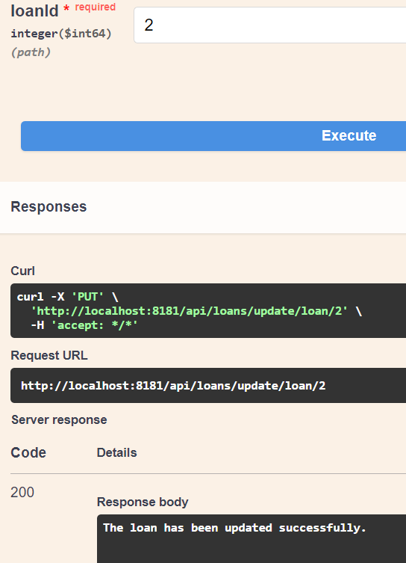
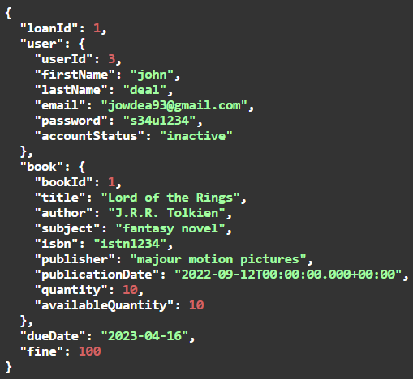


Demonstration
Book Loan Management: The system should allow the librarian to manage book loans,including tracking book due dates, sending reminders to users, and issuing fines for overdue books.

Slide 15
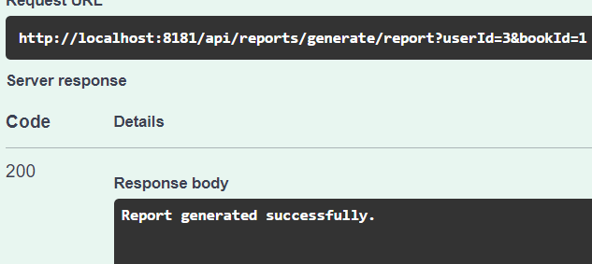
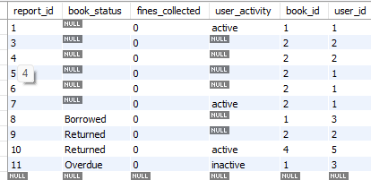
Demonstration
Reports: The system should generate reports on the status of books, user activity, and fines collected.

Slide 16
conclusion
In conclusion, the Simple and Small Library Management System Application is an efficient software solution that simplifies the management of library resources. By reducing administrative overhead and improving user experience, this system enhances the overall efficiency of library operations.

Slide 17
Thank you

